Slide 1
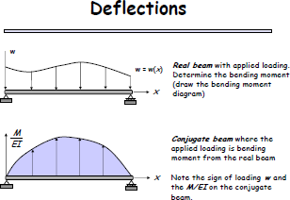
Conjugate-beam theory
THEORY OF STRUCTURES -------------------- DR. WISSAM D. SALMAN
It is one of methods for determining deformations (either displacement, or rotation at a point in a beam). It was developed by Muller-Breslau in 1865, and relies only on the principles of static, and hence its application will be more familiar.
The basis for this method comes from the similarity of the following equations.
Above equations states that
The slope at a point in the real beam is numerically equal to the shear at the corresponding point in the conjugate beam.
The displacement at a point in the real beam is numerically equal to the moment at the corresponding point in the conjugate beam

Slide 2
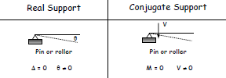
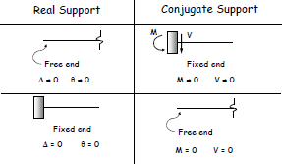
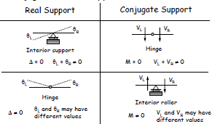
THEORY OF STRUCTURES -------------------- DR. WISSAM D. SALMAN
Conjugate- Beam supports:- when drawing the conjugate beam it is important that the shear and moment developed at the supports of the conjugate beam account for the corresponding slope and displacement of the real beams at its supports.

Slide 3
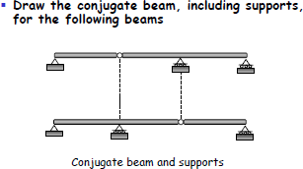
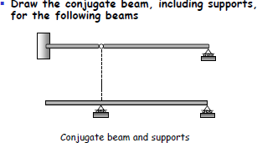
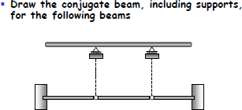
THEORY OF STRUCTURES -------------------- DR. WISSAM D. SALMAN

Slide 4
THEORY OF STRUCTURES -------------------- DR. WISSAM D. SALMAN
Example:- determine the slope and deflection at point B using conjugate-beam method, EI is constant
₁₀kN
₅₀kN.m
A
L=10^{m}
B
Solution
₁₀kN
1- Find the reactions at A
₁₅₀kN.m
₅₀kN.m
RA=10 ↑ , MA=150 C.C.W
A ₁₀kN
L=10^{m}
B
2-draw M/EI for beam,and draw conjugate beam
100/EI
M
A
B
150/EI
V
∑
∑
Note that sign negative indicate the slope is measured clockwise and displacement is downward

Slide 5
THEORY OF STRUCTURES -------------------- DR. WISSAM D. SALMAN
Example:- determine the slope at A and deflection at centre of beam using conjugate-beam method, EI is constant
WkN/m
A
B L
C
1- Find the reactions at A,C
RA,RB=wL/2↑
2-draw M/EI for beam,and draw conjugate beam
wl²/2EI
A
B
C
wl²/2EI
∑
V_{A}
∑
( )
(
)
( )
wl²/4EI M
B
A
l/2
V
wl²/8EI
Wl³/24EI

Slide 6
THEORY OF STRUCTURES -------------------- DR. WISSAM D. SALMAN
Example:- use the conjugate-beam method and determine the deflection and slope of the end C of the cantilever beam. EI=40000kN.m²
A B C
₄m
2.5I
₂m
I
100 kN.m
M
A
B
C
₄m 2.5I
2^{m} I
40/EI
100/EI
V
∑
[ ][ ] [ ][ ]
∑
[ ] [ ]
Example:- use the conjugate-beam method and determine the deflection at B and slope at C.
EI=constant
2kN
A
B
C
D
3m
3m
3m

Slide 7
THEORY OF STRUCTURES -------------------- DR. WISSAM D. SALMAN
1- Find reaction and draw M/EI diagram
2kN
A
B
C 4kN D
3m
3m
3m
24/EI
A
18/EI
B
C
D
3m
3m
3m
2- Draw conjugate beam
24/EI
A
18/EI
B
C
D
3m
3m
3m
24/EI
Vc 6/EI
3m6EI
A
18/EI
B
C
3m
3m

Slide 8
THEORY OF STRUCTURES -------------------- DR. WISSAM D. SALMAN
∑
[ ] [ ] [ ] [ ] [ ]
24/EI
A
18/EI
M
12/EI
Vc 6/EI
3m6EI
12/EI B
C
3m
∑
[ ] ] [ ]
[
[ ] [ ]
[ ] [ ]

